Slide 1
Chess Pieces Detection by YOLOv8

Slide 2
Steps
Dataset Preparation
Collecting Data
Labelling
Image Preprocessing
Augmentations
Training Model
Evaluating Performance of the Model
Testing Model

Slide 3
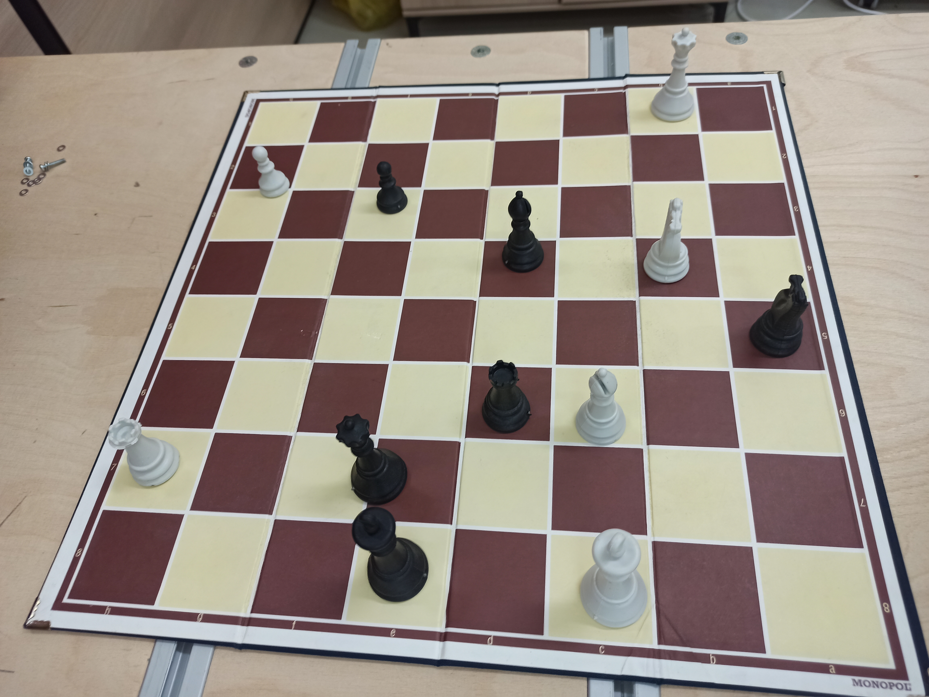
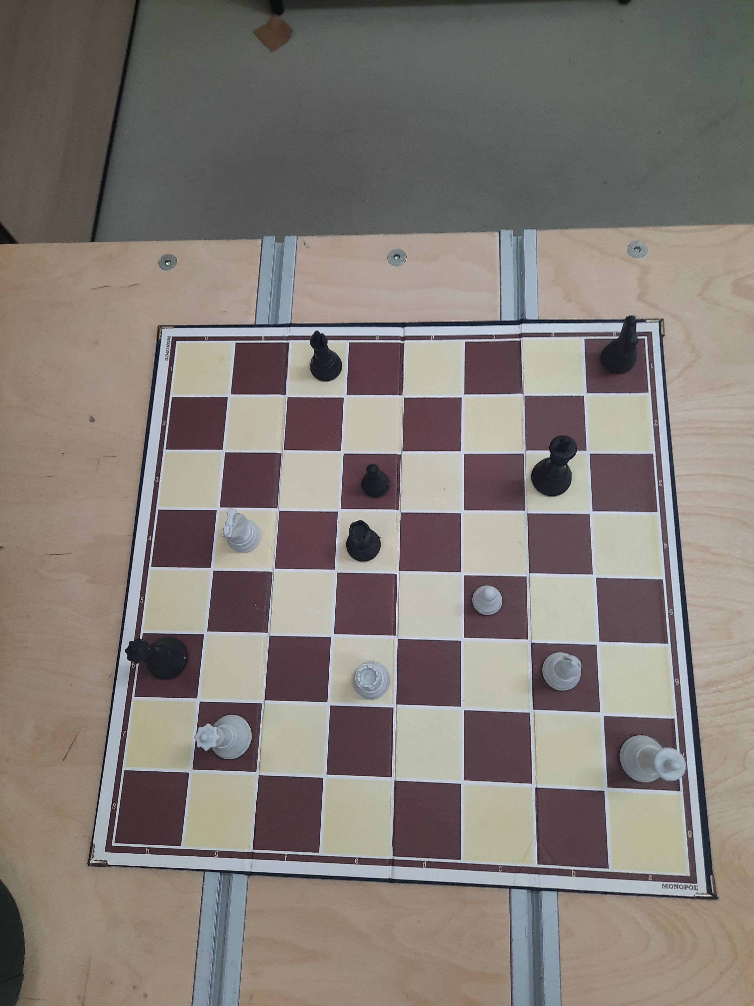
Collecting Data

Slide 4
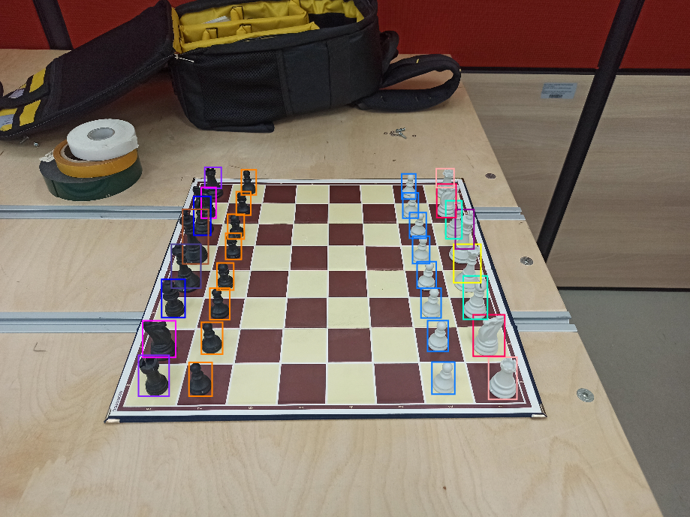
Labelling
Done by using Roboflow
12 classes created:
wknight
wpawn
wbishop
wrook
wking
wqueen
bknight
bpawn
bbishop
brook
bking
bqueen

Slide 5
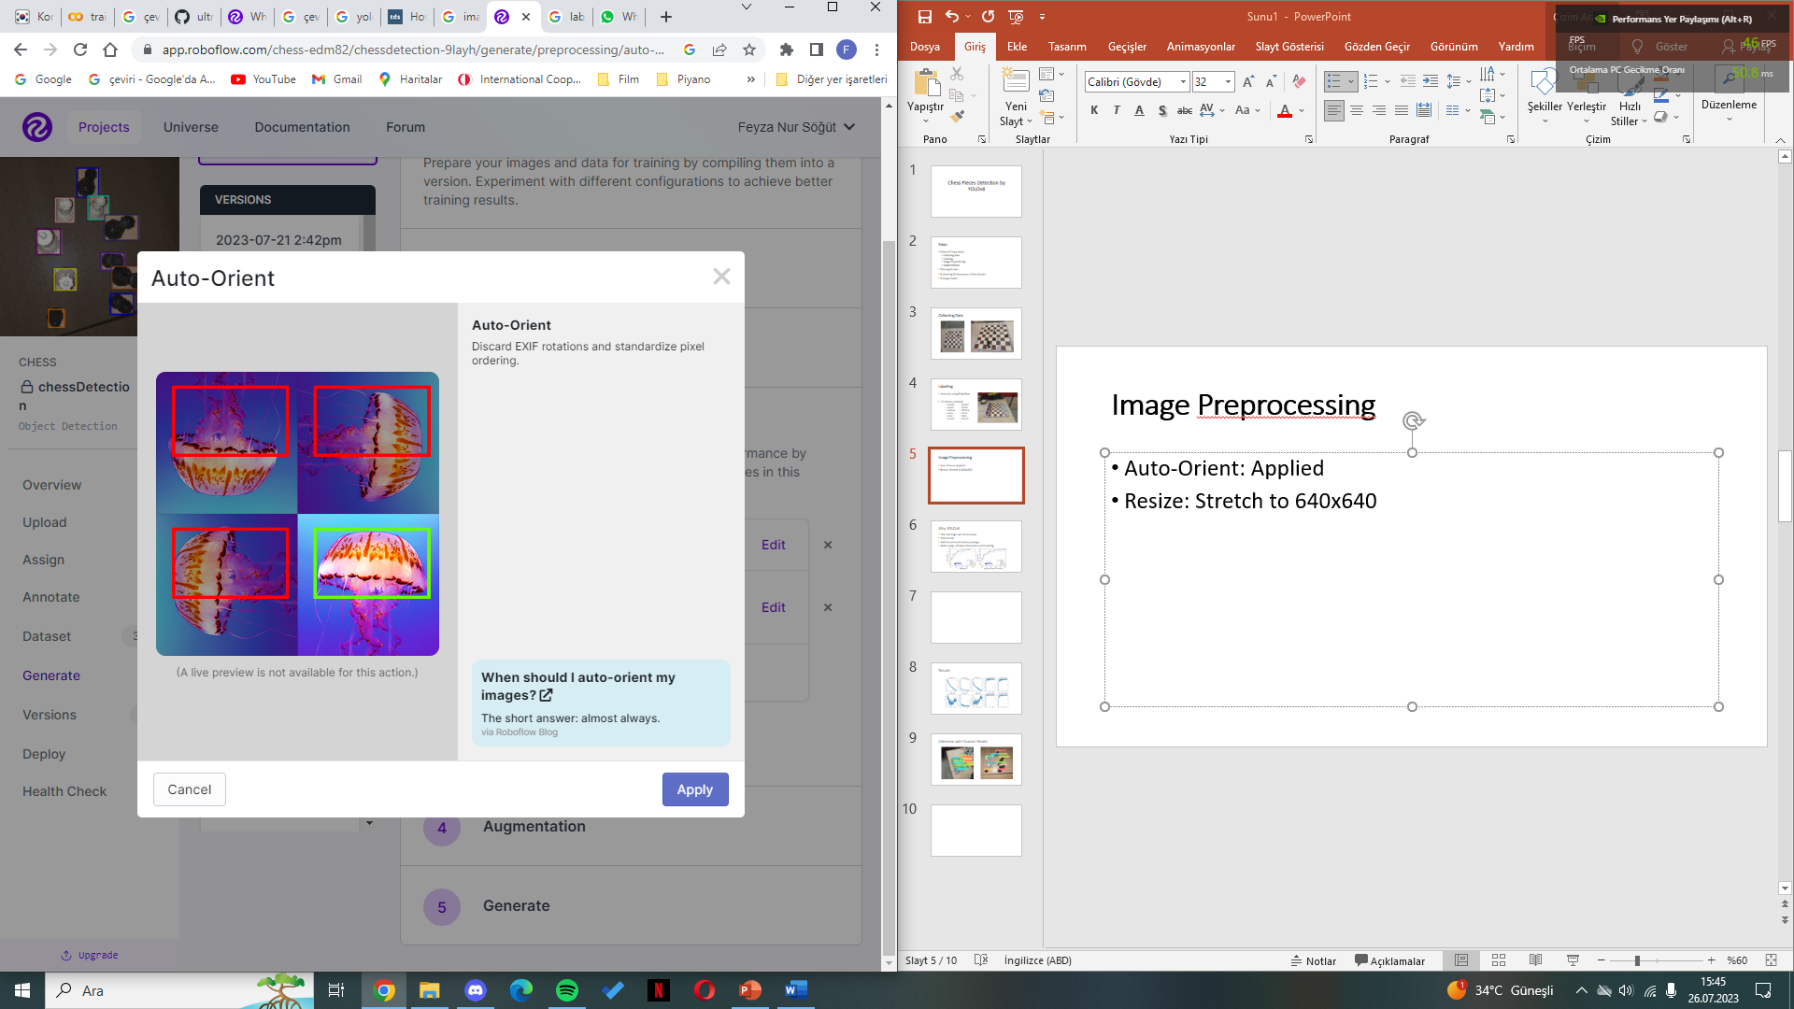
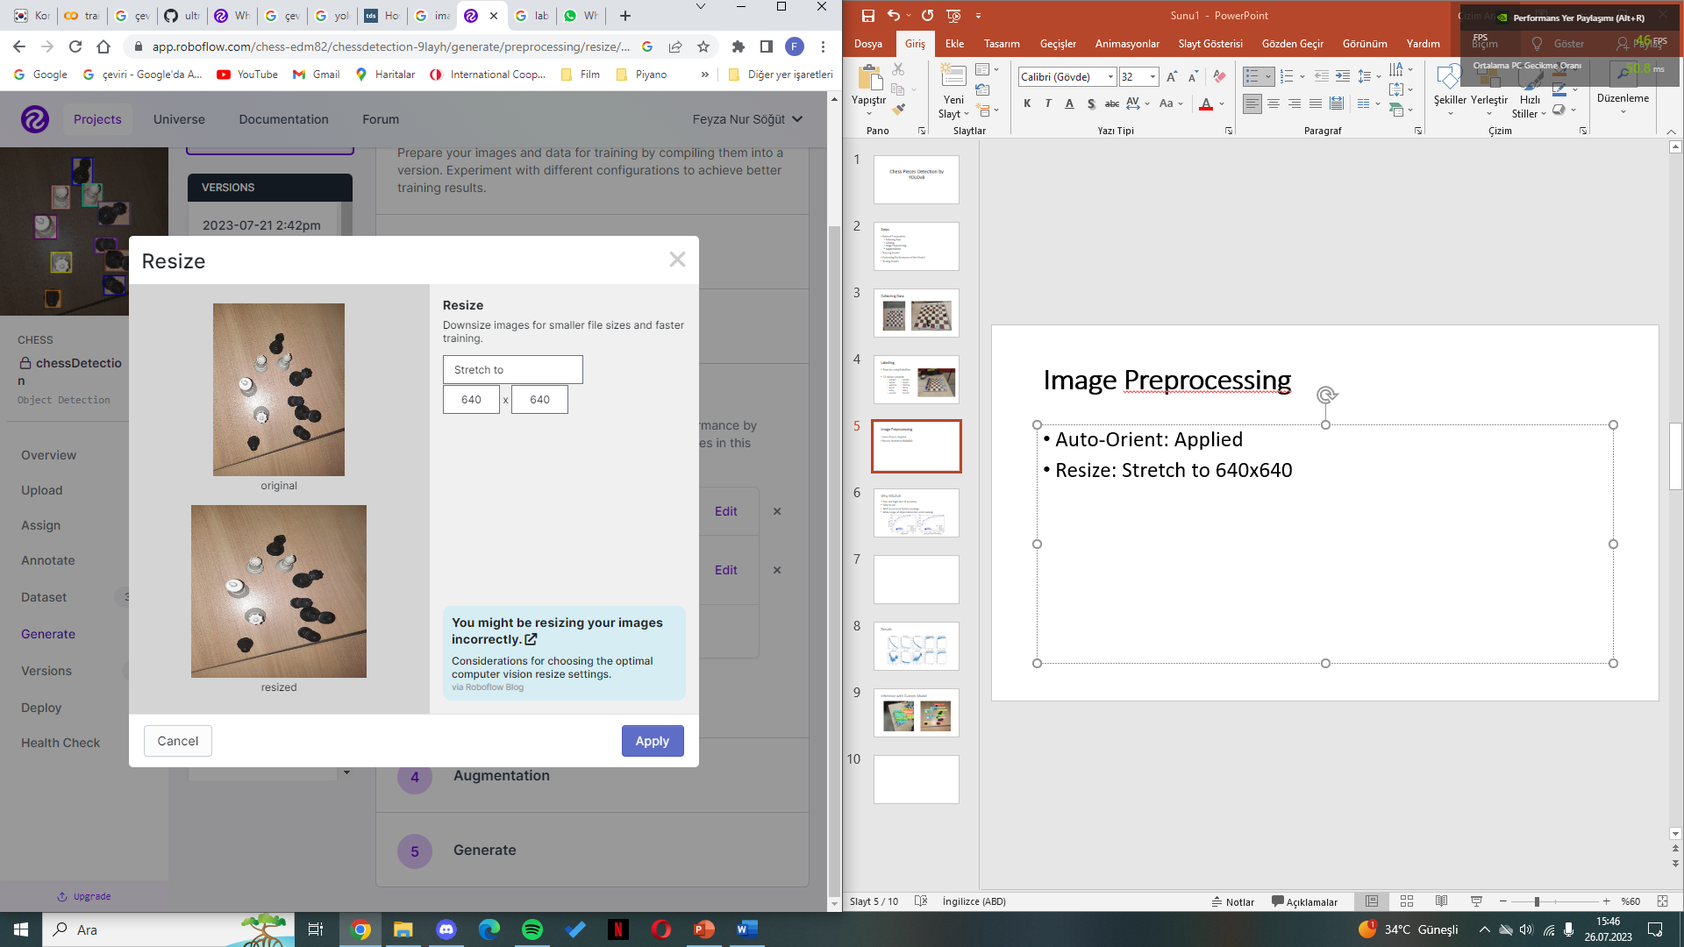
Image Preprocessing
Auto-Orient: Applied Resize: Stretch to 640x640

Slide 6
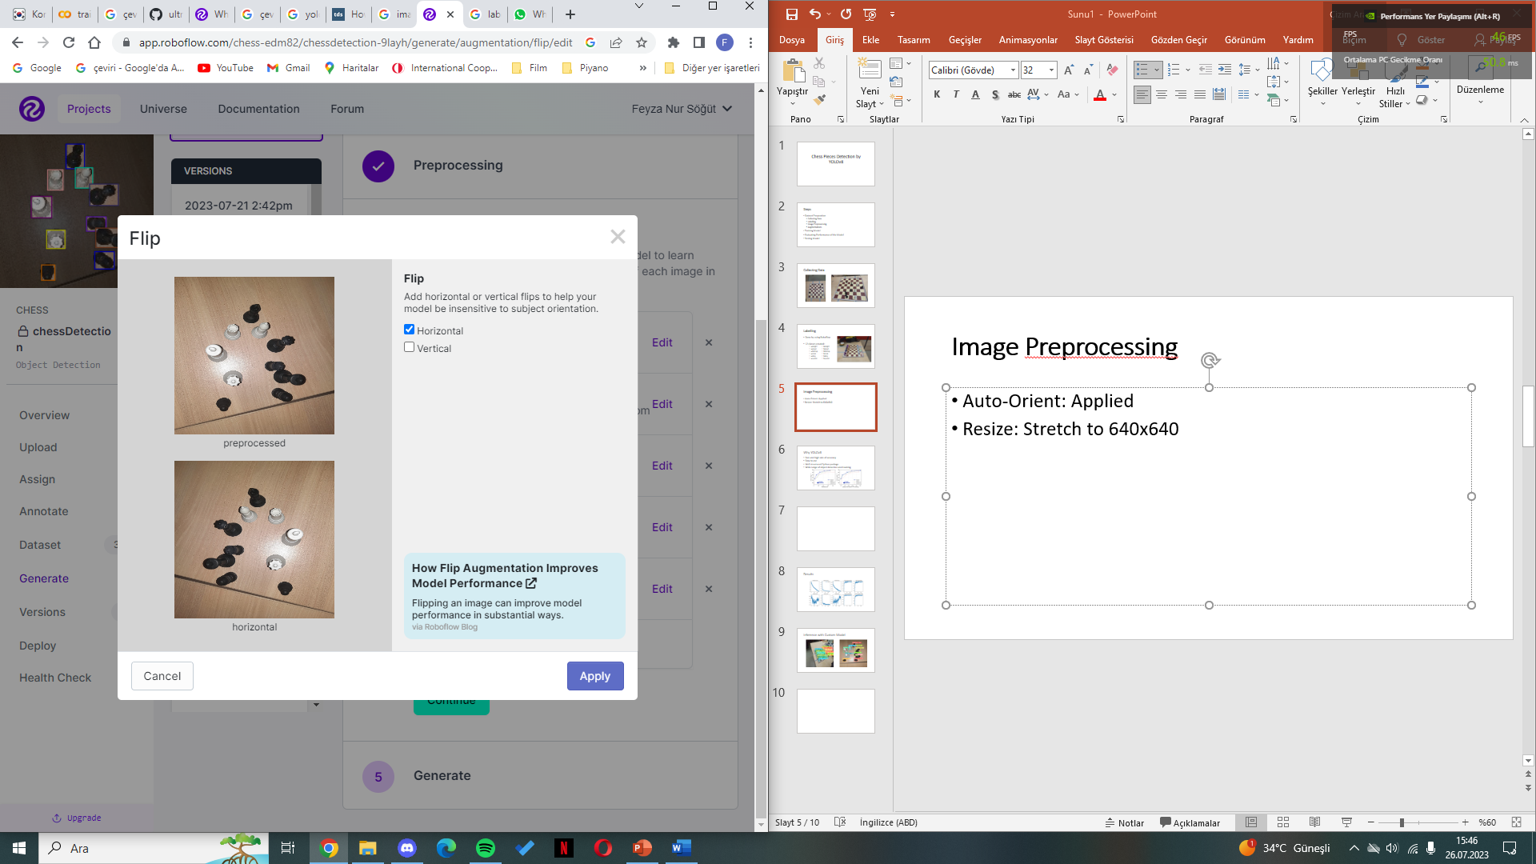
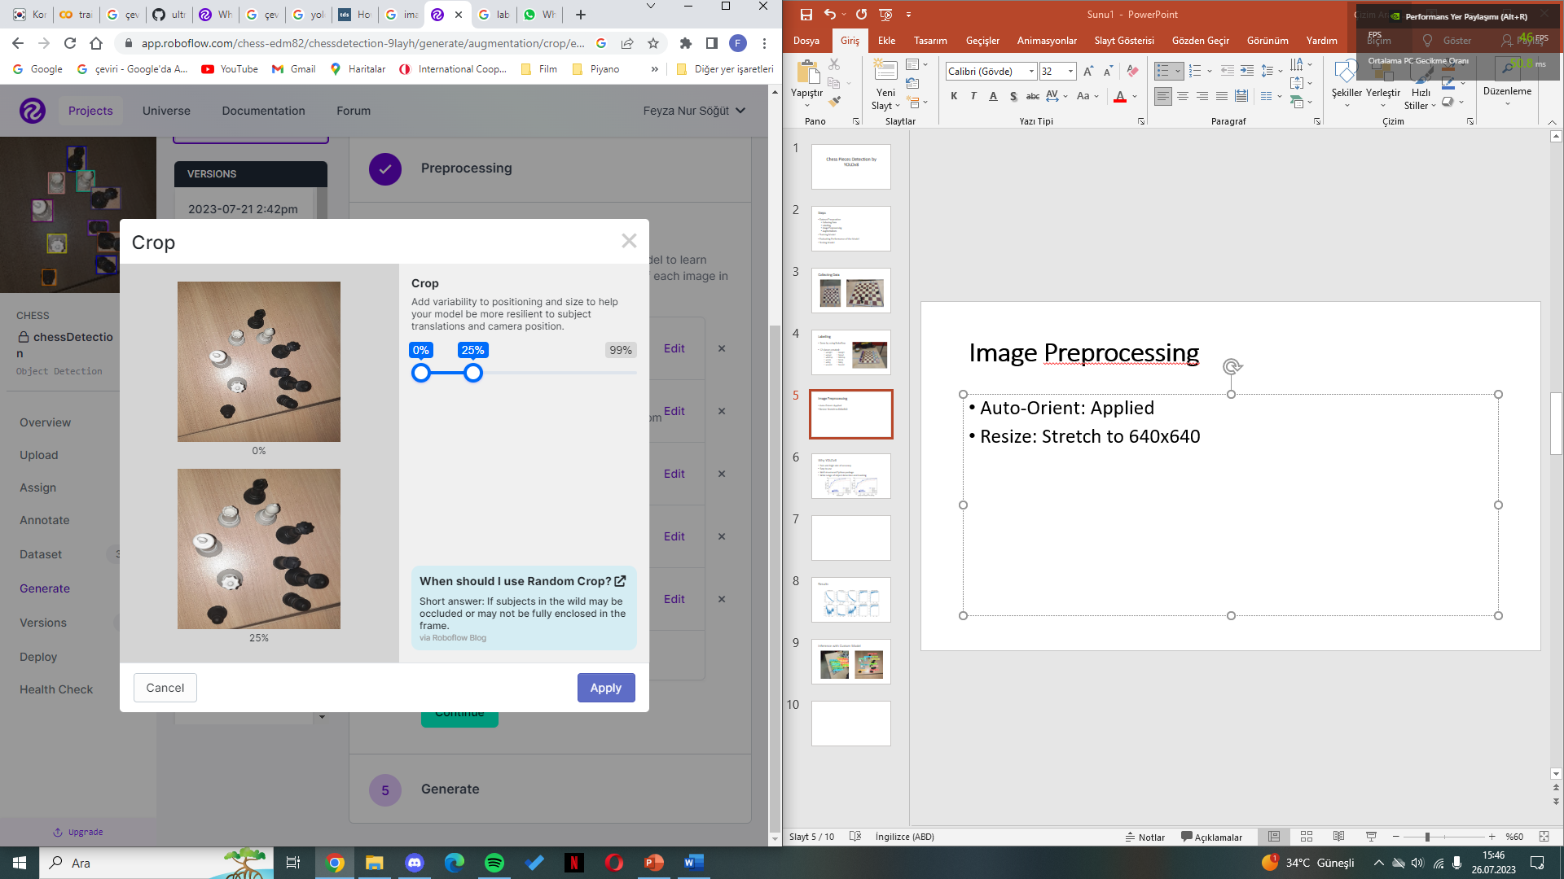
Augmentations
Flip: Horizontal Crop: 0% - 25%

Slide 7
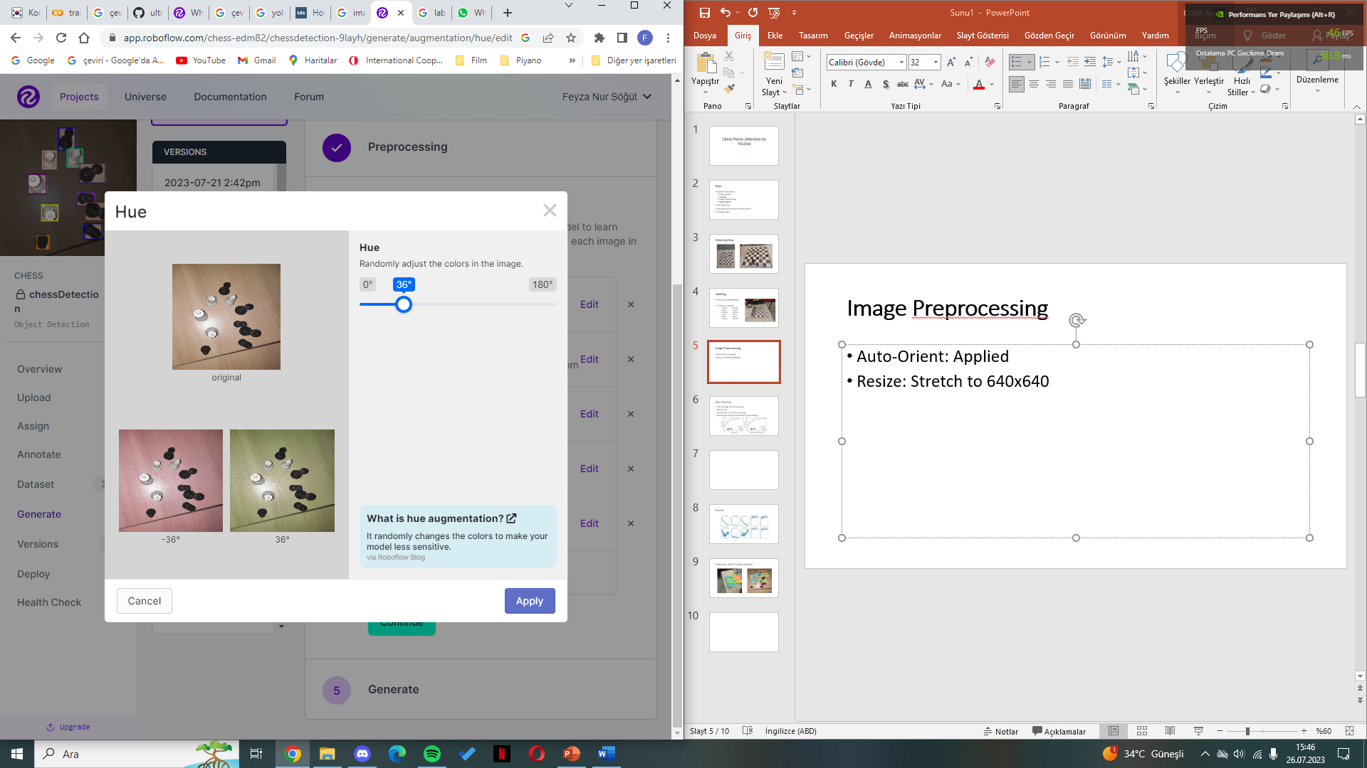

Augmentations
Hue: Between -36° and +36° Brightness: Between -22% and +22%

Slide 8
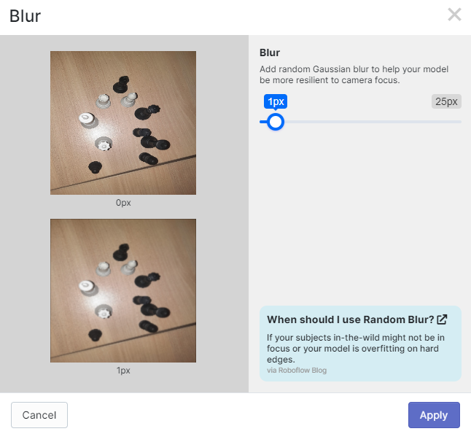
Augmentations
Blur: Up to 1px
1053 images have been collected!

Slide 9

Training Model
YOLOv8 has been used to detect chess pieces.

Slide 10
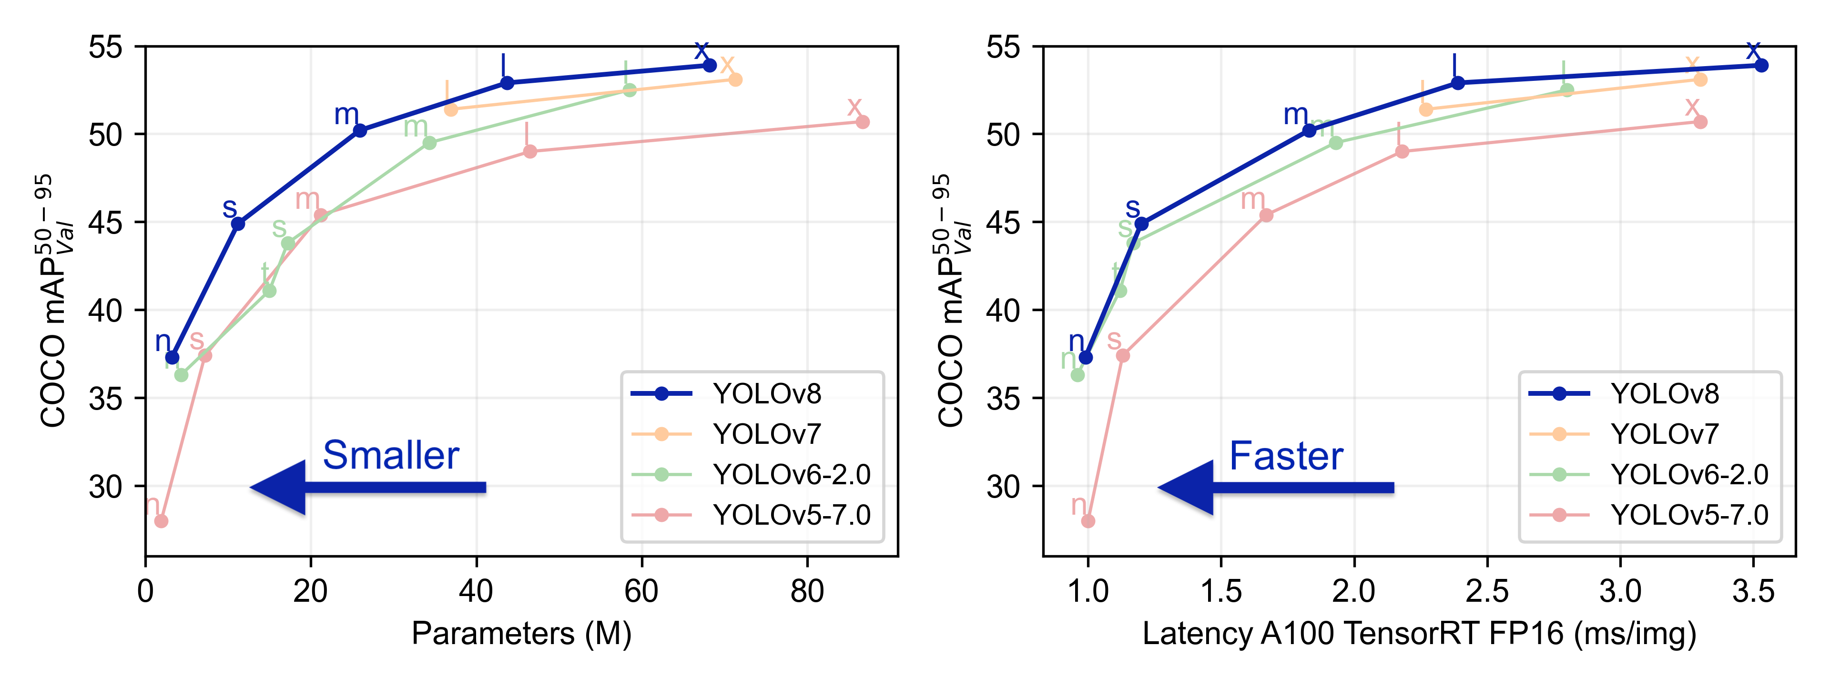
Why YOLOv8
Fast and high rate of accuracy
Easy to use
Well-structured Python package
Wide range of object detection and tracking

Slide 11
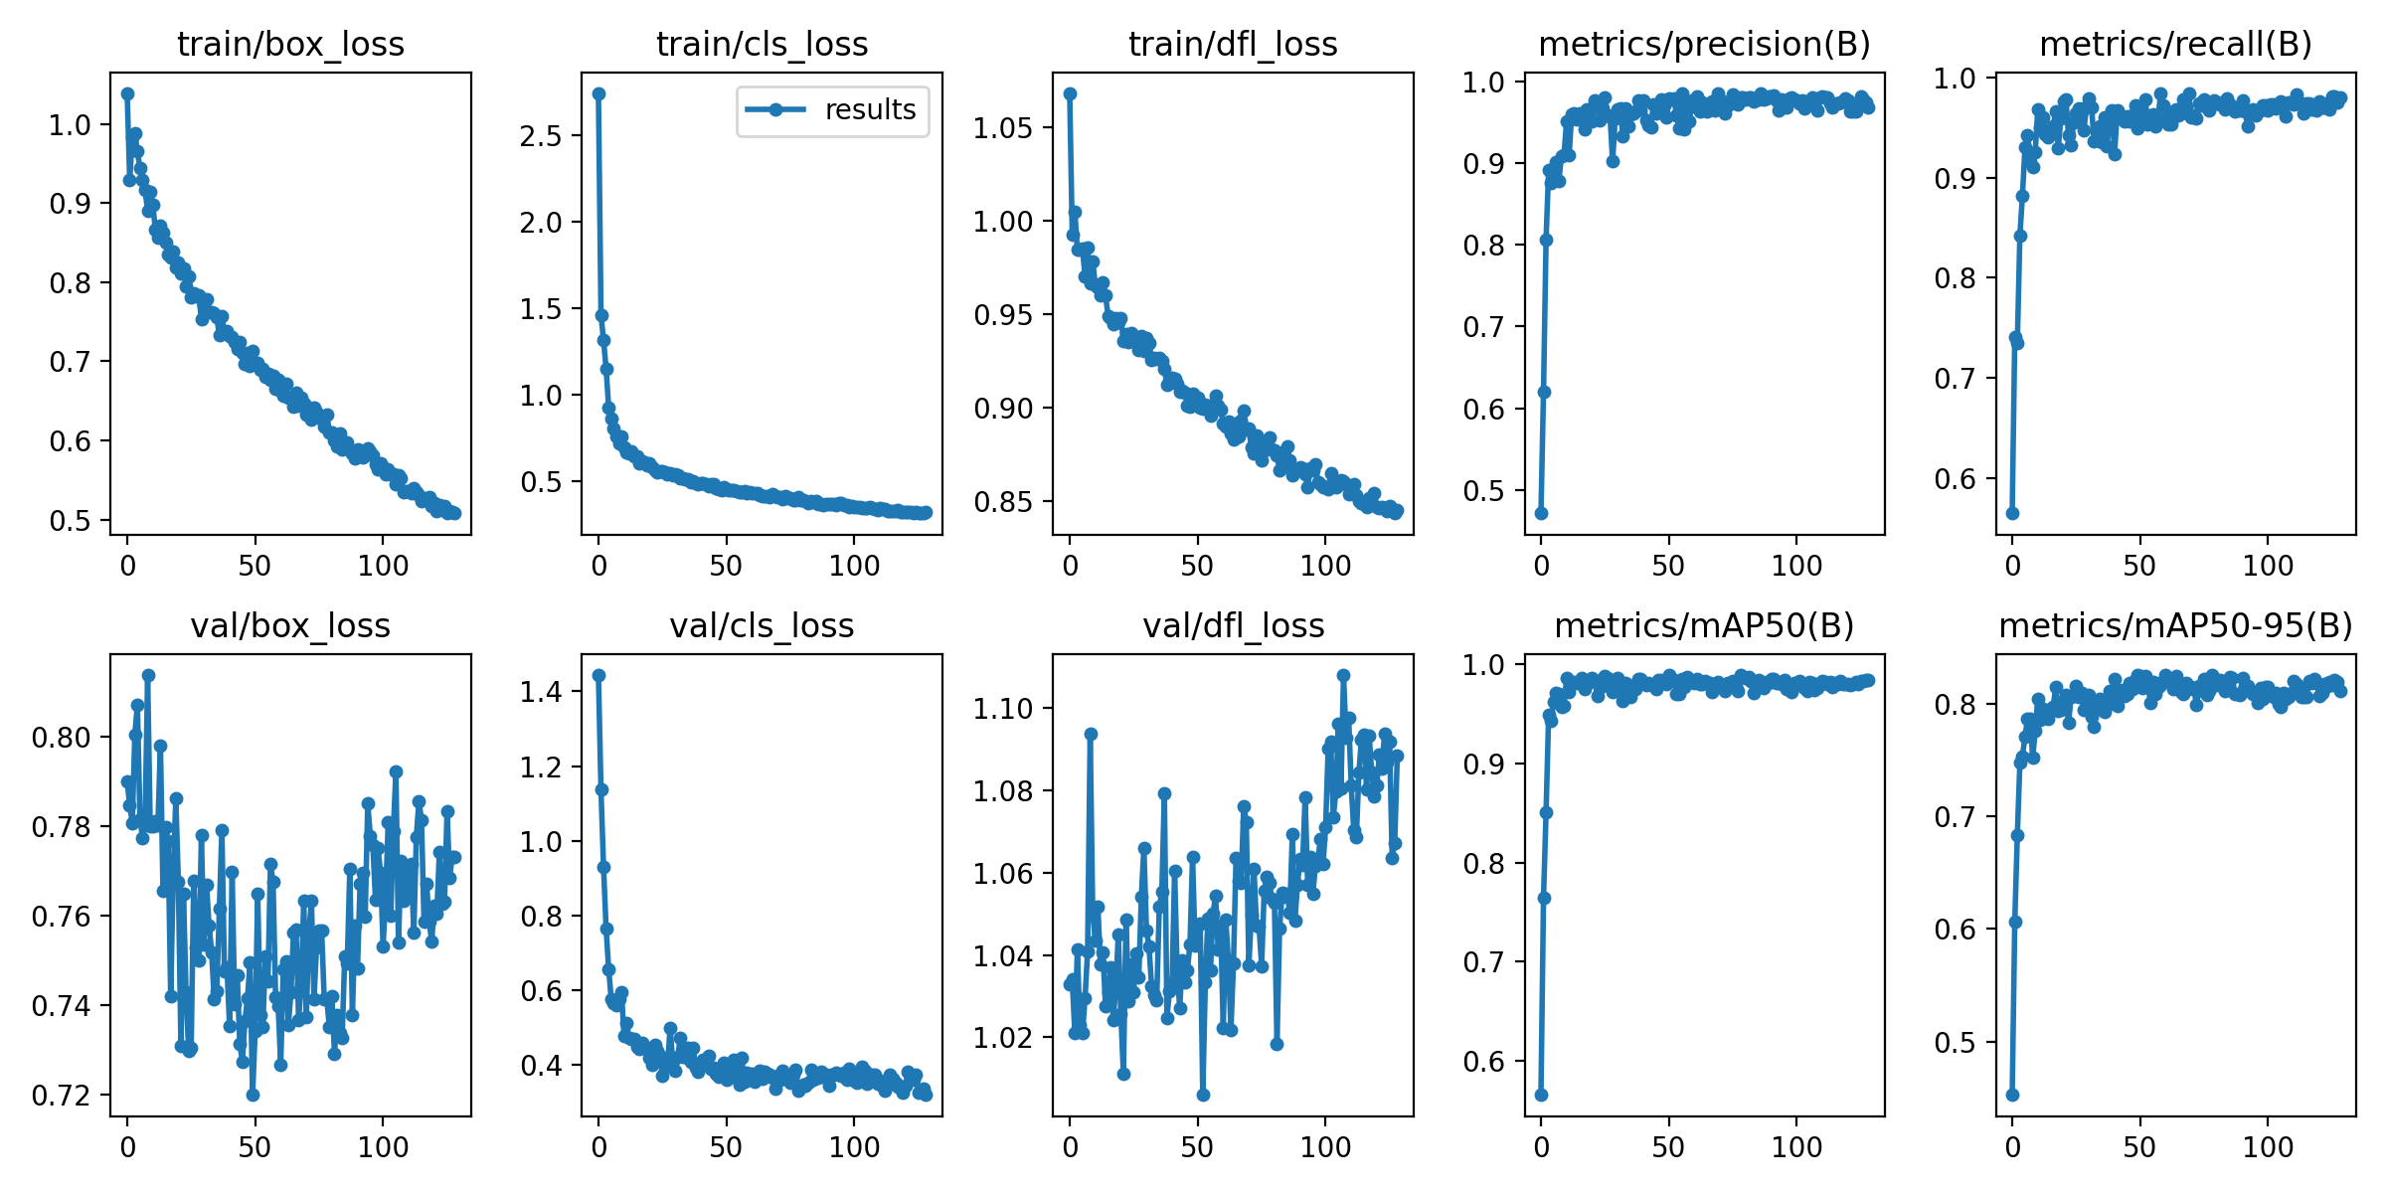
Evaluating Performance of the Model

Slide 12
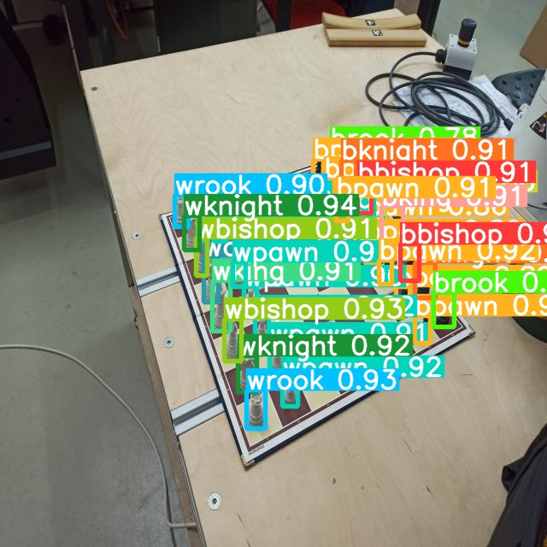
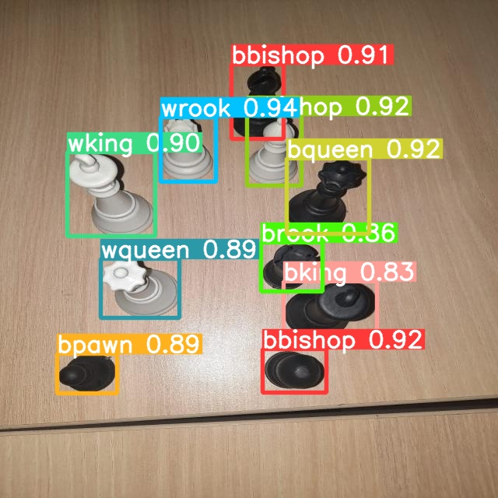
Testing Model

Slide 13
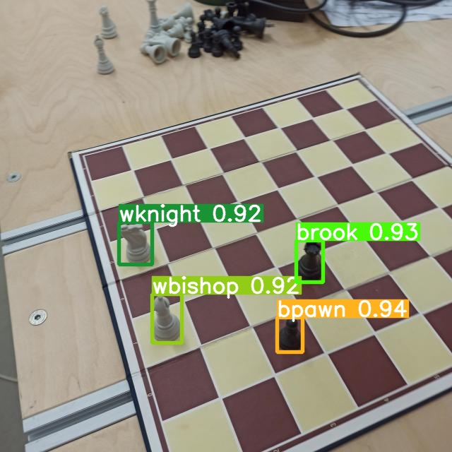
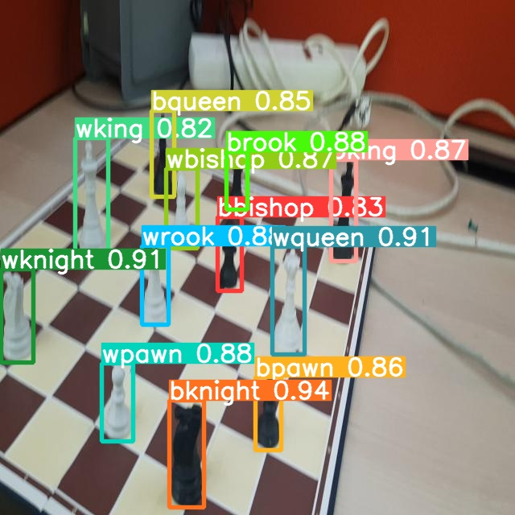
Testing Model

